Slide 1






MENTORME
By The Databaes

Slide 2





AROUND 1 IN 2 STUDENTS
Feel unprepared for future employment after graduation. Not having strong CVs or enough work experience
47%

Slide 3
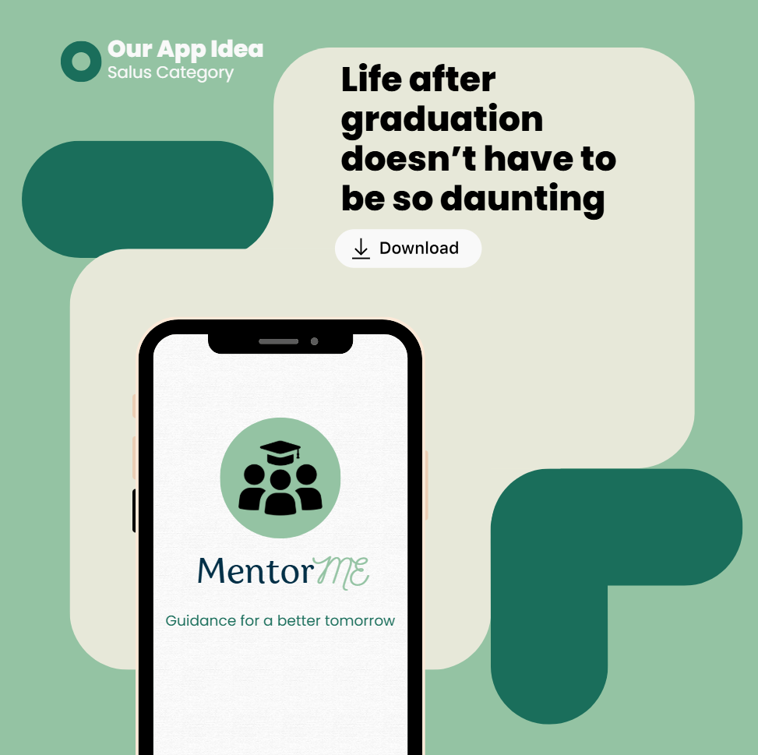

Slide 4



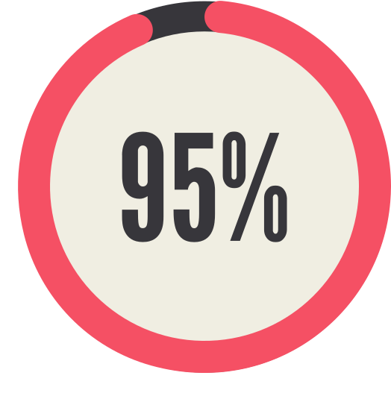









MENTORME, EASY AS:
1.
2.
3.
Create Profile
Hello, Jane Doe
Your roadmap
Name:
Jane Doe
Internship
Ready
Target Role:
Software Engineer
Looking For:
Internship
James Bond
Interest/Societies:
Basketball
Sr. Software Engineer - Amazon
Upload CV:
I specialise interview prep for assessment centres and OA
You’re here!
Upload CV to begin

Slide 5


&
CONNECT WITH

Slide 6


SET GOALS ALONGSIDE YOUR MENTOR
Jane’s Goal Tracker
Add your goal: ***************
75% Complete

Slide 7
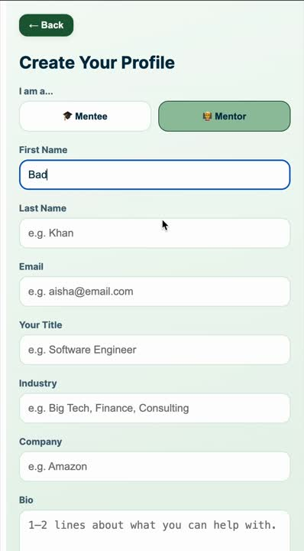

Slide 8
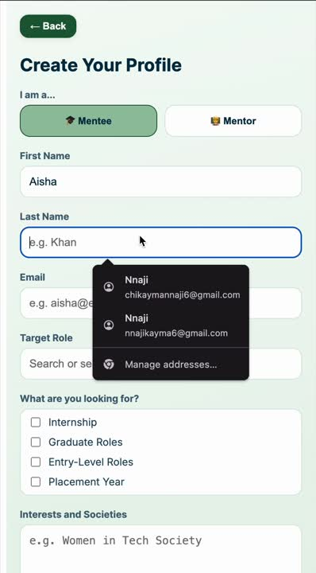

Slide 9
TO INFINITY AND BEYOND
A MOVEMENT, NOT JUST AN APP
Mentorship becomes culture.
Immediate. Structured. Scalable.
Community by default. Efficiency by design .
DIGITAL CAREER
DIARY
Upload Once, Grow Continously.
Auto Mentor match.
Skill gaps highlighted.
Job Applications tracked.
Progress logged over time.

Slide 10

WE’RE NOT ONLY REDEFINING EFFICIENCY...
WE’RE GUIDING YOU TOWARD OPPORTUNITY!

